Slide 1
Open Source Platform and Network Administration
Lesson 21

Slide 3
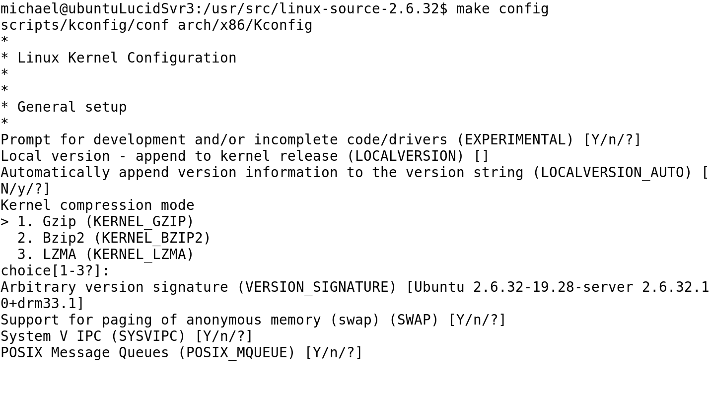
Customizing a Kernel with make config

Slide 4
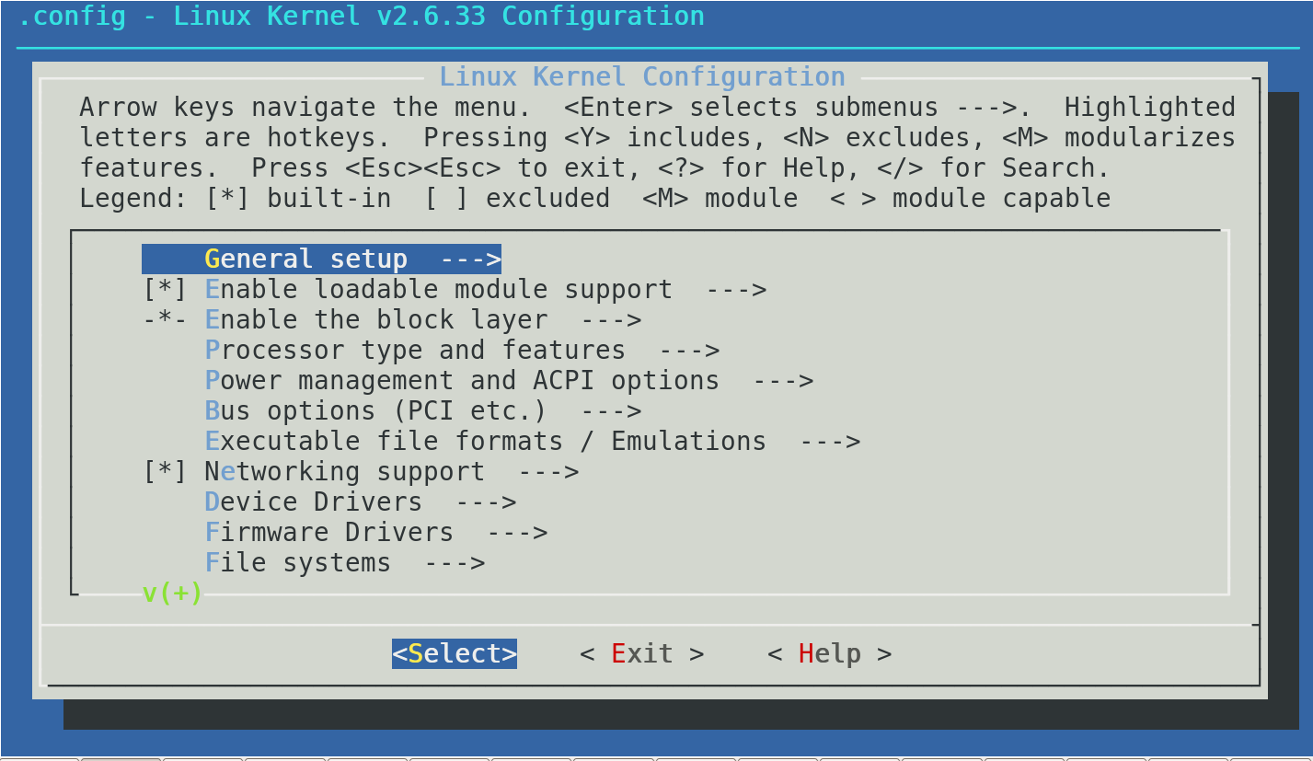
Customizing a Kernel with make menuconfig

Slide 5
Process to Compile a Kernel
Login as root and change directory to /usr/src.
Download the latest stable kernel from www.kernel.org.
Extract the compressed source tree into the /usr/src directory and create a symbolic link from the extracted directory to /usr/src/linux.
Configure what needs to be compiled into the kernel and then change into the /usr/src/linux directory by typing cd /usr/src/linux.
Type make menuconfig.
Notes:
If any errors occur when issuing the make menuconfig command, it probably means that the ncurses libraries are not installed on the computer system.

Slide 6
Process to Compile a Kernel (Continued)
Save the options selected when exiting out of the menu interface.
Type make.
Type make modules.
Type make modules_install.
Type make install.

Slide 7
Vendor-Supplied and Custom Kernel
Vendor-Supplied Kernel
Pros
Easier to apply patches and updates, easier to maintain, and has a system to address security issues
Cons
Has generic builds that are not optimized for the specific hardware that will run the kernel
Often times contains more features and modules than are needed

Slide 8
Vendor-Supplied and Custom Kernel (Continued)
Custom Kernel
Pros
Optimized for specific hardware
More secure because only the needed features and modules are compiled into the kernel
Cons
Need to recompile when patches are available
Requires a Linux system administrator to manage kernel updates

Slide 9
Benefits of Installing a New Kernel
Installing is less riskier than upgrading because a computer system can become unstable or even unbootable after an upgrade.
If the new kernel causes the computer system to become unbootable or unstable, the older kernel will still be available to run the system until the issue is resolved.

Slide 10
Kernels and the /proc/ Filesystem
Broadcast Replies
ICMP Message
SYN Floods
Reverse Path Filtering
Routing Tables
Source Routing
Network Traffic
Packets

Slide 11
Summary
Vendor-supplied and custom Linux kernel
Process to patch and compile a Linux kernel
Role of a Linux system administrator in securing the Linux kernel
Use of LKM to secure the Linux kernel
Benefits of installing a new kernel

Slide 12
Virtual Lab
Hardening Security for the Linux Kernel
Notes:
If your educational institution included the Jones & Bartlett labs as part of the course curriculum, use this script to introduce the lab:
"In this lesson, you delved deeper into the Linux kernel. You learned that the kernel is highly configurable and black-hat hackers are quick to take advantages of mistakes made by less skilled network administrators. You explored configuration options for the stock kernel and even considered the option for building a custom kernel.
In this lab, you will view and tune all kernel parameters and discover information regarding the current Loadable Kernel Modules (LKMs) and information about the kernel itself. You will explore the sysctl.conf file and make modifications to system settings. Finally, you also will enable and interpret the results of the lsmod command."

